Slide 1
Beginning ESL

Slide 2
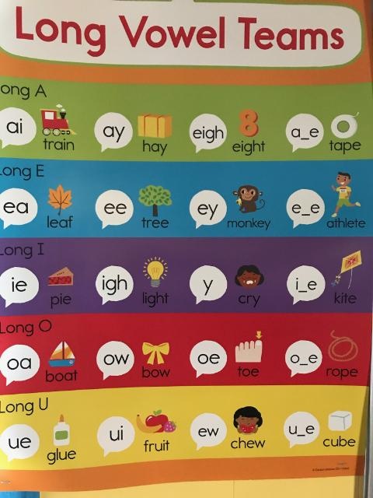
Beginning ESL

Slide 3
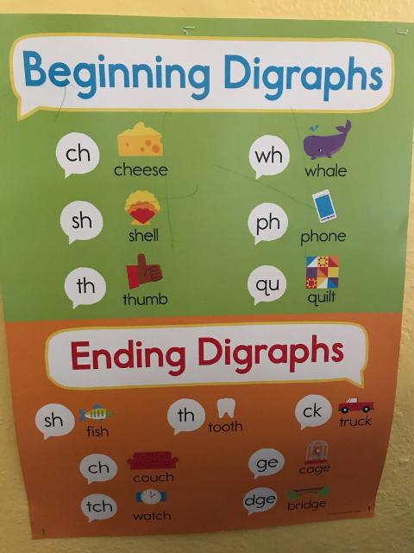
Beginning ESL

Slide 4
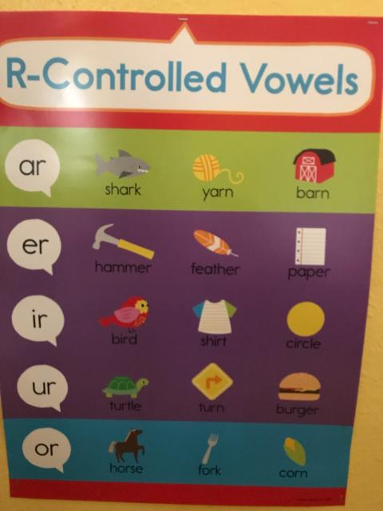
Beginning ESL

Slide 5
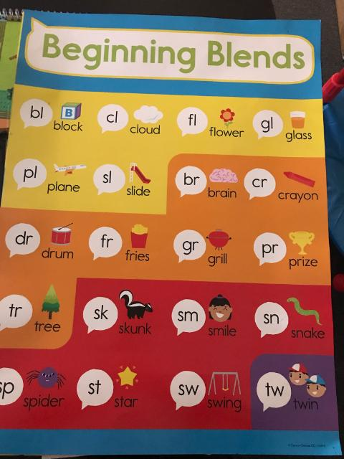
Beginning ESL

Slide 6
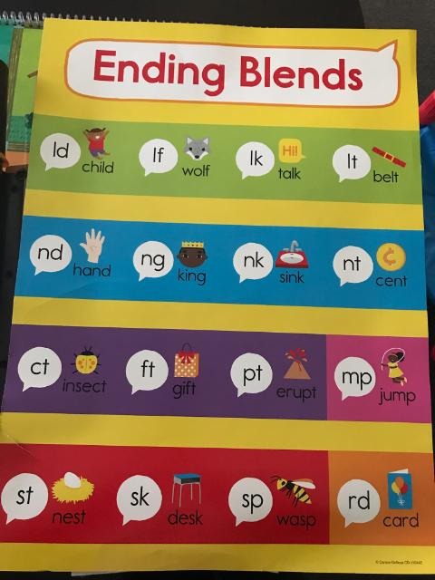
Beginning ESL

Slide 7
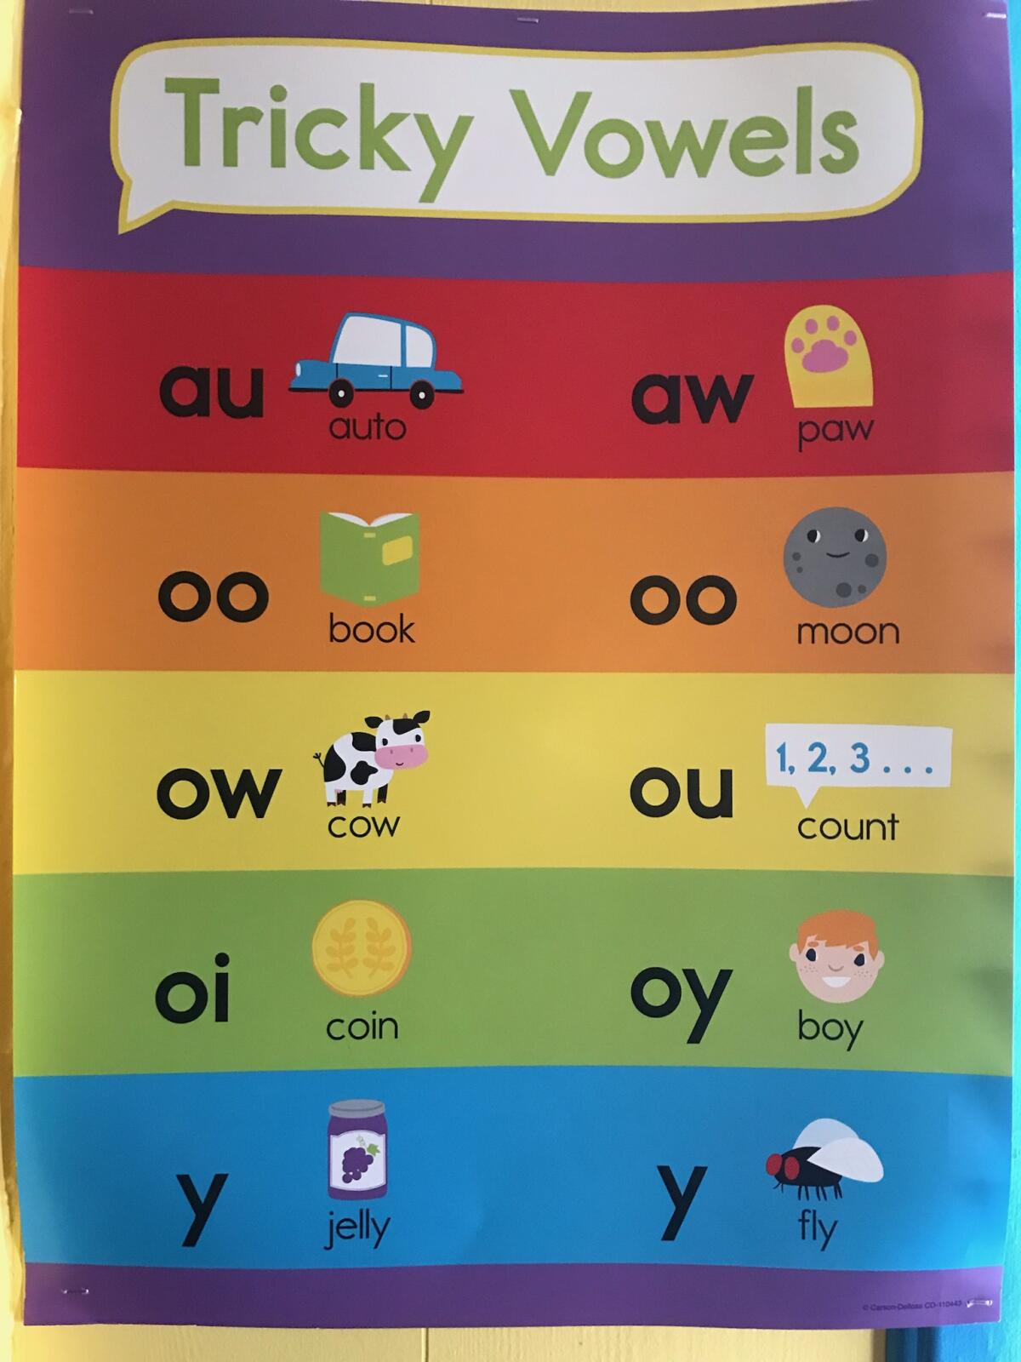
Beginning ESL

Slide 8
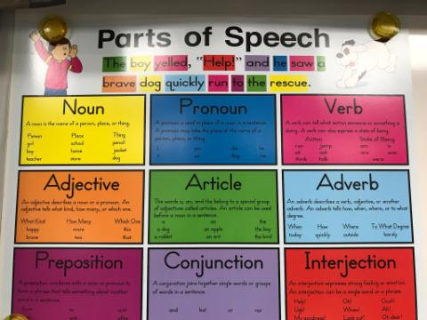
Beginning ESL

Slide 9
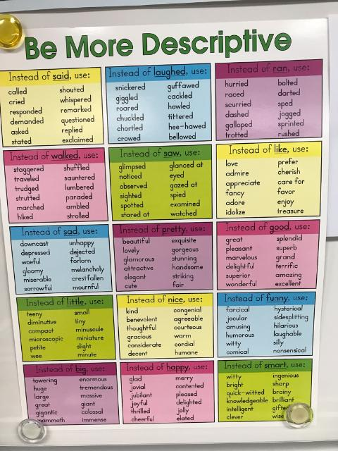
Beginning ESL

Slide 10
Beginning ESL

